Slide 1
Spherical Trigonometry

Slide 2
P
Great Circle
Any Plane Passing Through the Center of Sphere cuts the Sphere in a Circle.
F
R
D
Small Circle
Any Other Plane Intersecting the Sphere, but not passing through the Center. (i.e. cutting the Surface of the sphere)
C
E
o
B
If
there are any other Points on the Surface of a Sphere, then
the Sphere can be Bisected so that all three Points lie on the same Hemisphere.
A
Q
Arc FCD at Point R is not a Great Circle

Slide 3
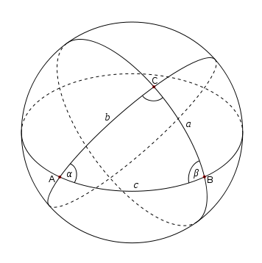
If
The Points are joined by Great Circle arcs all lying on the Hemisphere, then
the Figure obtained is called a Spherical Triangle.
On a sphere, the corresponding sum is always greater than 180° but also less than 540°.
O
180° < α + β + γ < 540°
For Spherical Triangle ABC
AB, BC, CA are the Sides
And α, β, γ are the Spherical Angles
r
If r is the Radius of the Sphere
the length of Spherical Arc AC is given by
AC = r . Ang(AOC)
AC = r. α
(α is in Radian)

Slide 4

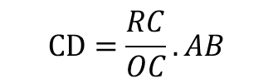

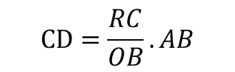



Length of small Circle Arc
Consider small circle arc CD
P
CD = RC x angle(CRD)
Also, AD = OA x angle(AOB)
F
R
D
C
Now, the plane(FCD) is parallel to the Plane(EAB)
Then, CRD = AOB
E
o
So, for RC||OB and RD||OB
B
$$CD=\frac{RC}{OB}.AB$$
A
$$CD=\frac{RC}{OC}.AB$$
(OB = OC = radius)
We have, RC Ʇ OR
$$RC=OC\cos{RCO}$$
Q
$$CD=AB\cos{RCO}$$
$$=AB\cos{AOC}$$
Since, AOC is the angle subtended at center of the sphere by
the great Circle arc AC.
$$CD=AB\cos{AC}$$
( PA = 90 ̊)
$$CD=AB\sin{PC}$$

Slide 5

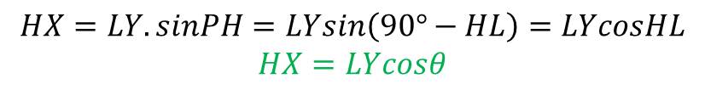
P
Longitude are measured from 0° to 180° east of Greenwich meridian and 0° to 180° west.
Greenwich
M
X
G
H
Meridian through J cuts the equator at point L and the angle(LOJ) or great Circle arc LJ, is called the latitude of J.
J
If J is between equator and the north pole P,
latitude is said to be north(N).
If R is between equator and the South pole Q,
latitude is said to be south(S).
N
o
Y
K
L
Let ϕ denote the latitude of J.
then LOJ or LJ = ϕ
Since OP is Ʇ to equator, POL = 90° POJ = 90° - Lat
R
west
east
Angle(POJ) or Spherical arc PJ is the colatitude of J.
colatitude = 90° - Lat
Q
$$HX=LY.sinPH=LYsin\left(90°−HL\right)=LYcosHL$$
$$HX=LYcosθ$$

Slide 6






Let AD be the tangent to the great circle AC at A and AE be the tangent to BC at great circle BA
$$∠BAC=DAE=A$$
Now in plane OAD, OAD is 90° and
$$∠AOD=∠AOB$$
then
$AD=OAtanC$ &
O$D=OAsecC$
…(3)
O
From the plane triangle OAE, we have
$AE=OAtanb$ &
$$OE=OAsecb$$
…(4)
B
From the plane triangle DAE
a
c
C
$${DE}^{2}={AD}^{2}+{AE}^{2}−2AD.AE.cos⁡(DAE)$$
b
$${DE}^{2}={(OA.tanc)}^{2}+{(OA.tanb)}^{2}−2(OA.tanc).(OA.tanb).cos⁡A$$
A
$${DE}^{2}={OA}^{2}[\tan^{2}c+\tan^{2}b−2tanb.tanc.\cos{A}]$$
…(5)
D
E
From the plane triangle DOE
$${DE}^{2}={OD}^{2}+{OE}^{2}−2OD.OE.cos⁡(DOE)$$
(DOE = BOC = a)
$${DE}^{2}={(OA.secc)}^{2}+{(OA.secb)}^{2}−2(OA.secc).(OA.secb).cos⁡A$$
$${DE}^{2}={OA}^{2}[\sec^{2}c+\sec^{2}b−2secb.secc.\cos{a}]$$
…(6)

Slide 7


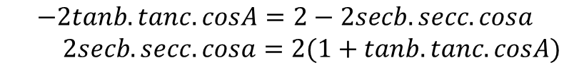
Using (5) = (6)
$$\tan^{2}c+\tan^{2}b −2tanb.tanc.cosA=\sec^{2}b+\sec^{2}c−2secb.secc.cosa$$
Now,
$\sec^{2}c=1+\tan^{2}c$ & $\sec^{2}b=1+\tan^{2}b$
$$\tan^{2}c+\tan^{2}b −2tanb.tanc.cosA=1+1+\tan^{2}b+\tan^{2}c−2secb.secc.cosa$$
O
$$−2tanb.tanc.cosA=2−2secb.secc.cosa$$
$2secb.secc.cosa=2(1+tanb.tanc.cosA)$
B
$$cosa=\frac{1}{secb.secc}+\frac{tanb.tanc.cosA}{secb.secc}$$
a
C
c
b
A
$cosa=cosb.cosc+sinb.sinc.cosA$ …(A)
D
E
Equation (A) is known as fundamental formula of spherical trigonometry (cosine formula) and Similarly others can be derived.
$cosb=cosc.cosa+sinc.sina.cosB$ …(7)
$cosc=cosa.cosb+sina.sinb.cosC$ …(8)

Slide 8
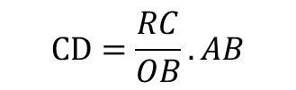
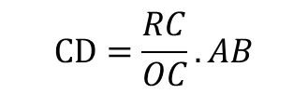





Length of small Circle Arc
Consider small circle arc CD
P
CD = RC x angle(CRD)
Also, AD = OA x angle(AOB)
F
R
D
C
Now, the plane(FCD) is parallel to the Plane(EAB)
Then, CRD = AOB
E
o
So, for RC||OB and RD||OB
B
A
(OB = OC = radius)
We have, RC Ʇ OR
Q
Since, AOC is the angle subtended at center of the sphere by
the great Circle arc AC.
( PA = 90 ̊)

Slide 9
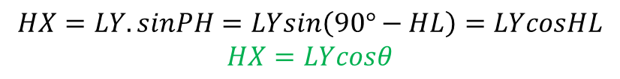
Terrestrial latitude and longitude
P
Longitude are measured from 0° to 180° east of Greenwich meridian and 0° to 180° west.
Greenwich
M
X
G
H
Meridian through J cuts the equator at point L and the angle(LOJ) or great Circle arc LJ, is called the latitude of J.
The angle KOL is defined to be the longitude of the meridian PHQ.(equatorial arc KL or spherical angle KPL)
J
N
o
Y
If J is between equator and the north pole P,
latitude is said to be north(N).
If R is between equator and the South pole Q,
latitude is said to be south(S).
K
L
R
west
east
Let ϕ denote the latitude of J.
then LOJ or LJ = ϕ
Since OP is Ʇ to equator, POL = 90° POJ = 90° - Lat
Q
Angle(POJ) or Spherical arc PJ is the colatitude of J.
colatitude = 90° - Lat

Slide 10






Fundamental Formula for Spherical Trigonometry
Let AD be the tangent to the great circle AC at A and AE be the tangent to BC at great circle BA
Now in plane OAD, OAD is 90° and
then
…(3)
O
From the plane triangle OAE, we have
…(4)
B
From the plane triangle DAE
a
c
C
b
A
…(5)
D
E
From the plane triangle DOE
(DOE = BOC = a)
…(6)

Slide 11

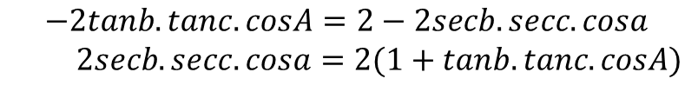

Using (5) = (6)
Now,
O
B
a
C
c
b
A
D
E
Equation (A) is known as fundamental formula of spherical trigonometry (cosine formula) and Similarly others can be derived.

Slide 12
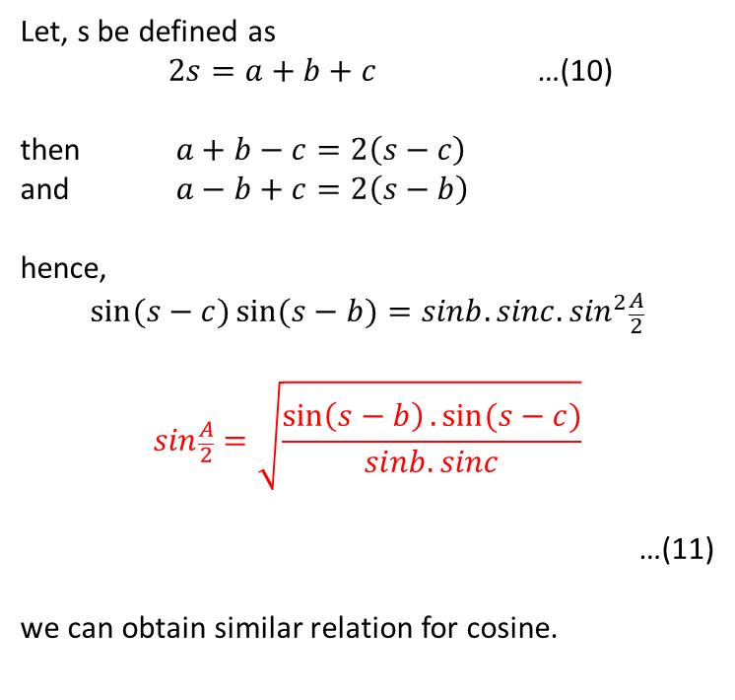
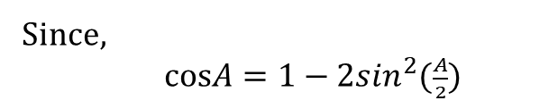
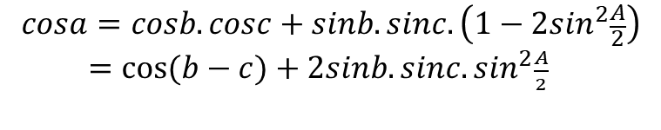
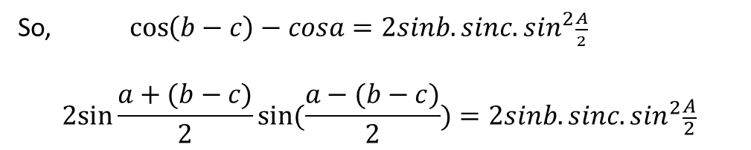
Use of fundamental formula(A)
When all three Sides are given
Angle of triangle can be found by cosine-formula.
For two sides and one angle
Say, b and c , and the included angle A of a spherical triangle ABC are known,
Then cosine-formula can be used to calculate the third side a to be made.

Slide 13
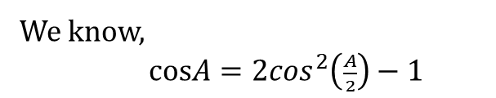
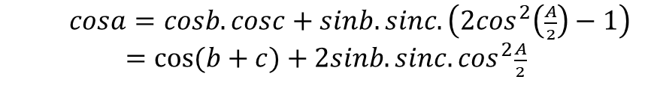
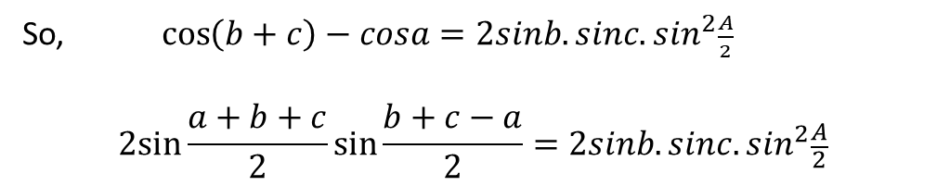
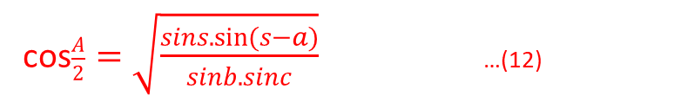
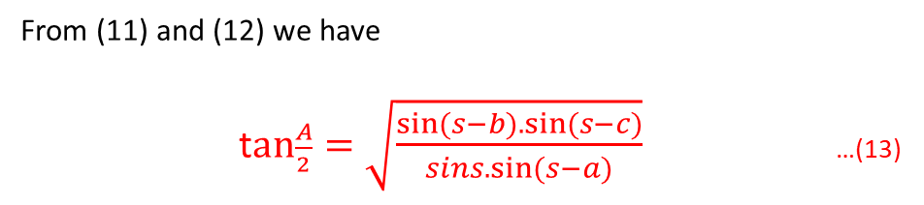
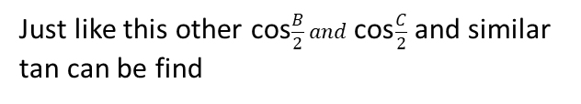

Slide 14
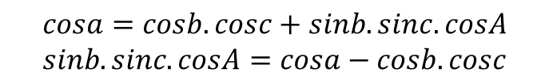
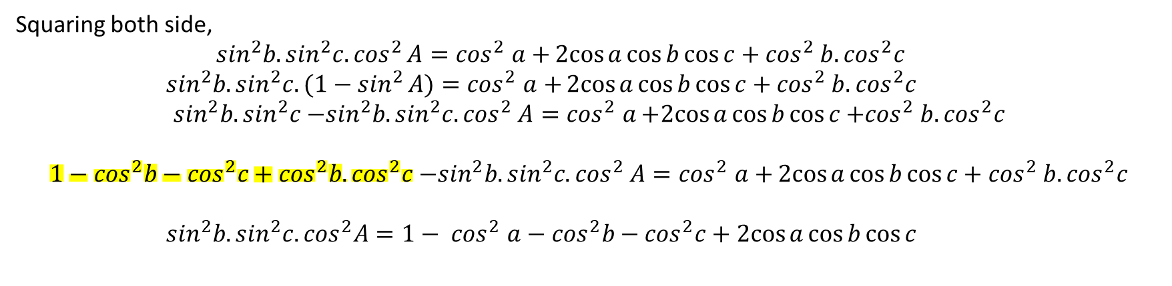
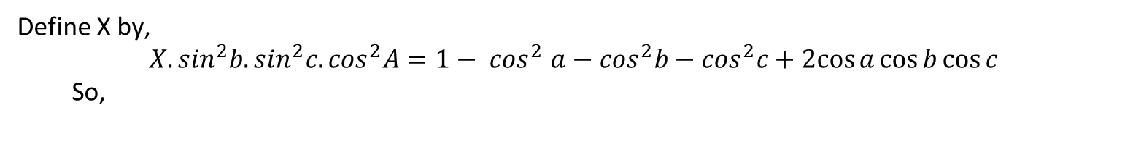
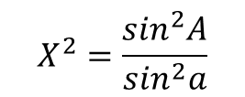
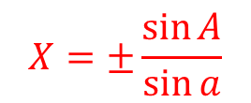
The sine formula
From the cosine formula (A) , we have

Slide 15

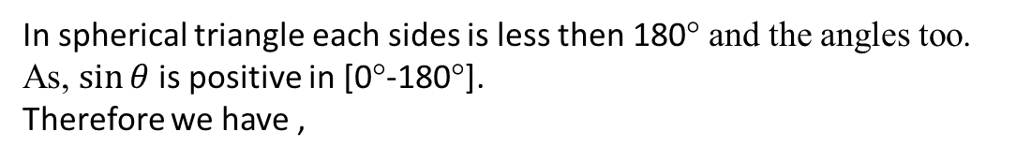
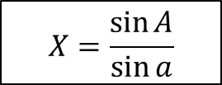
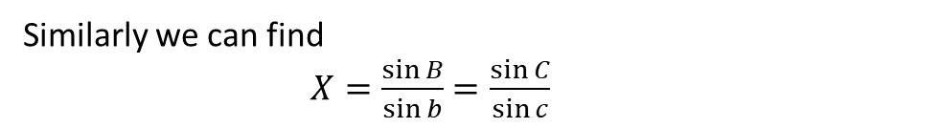

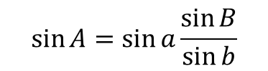
We have
This formula (B) is known as sine-formula
It gives the relation between any two sides of triangle and two angles opposite these sides.

Slide 16

Now we have formula 7
We can write it as
$$\sin{c}\sin{a}\cos{B}=\cos{b}−\cos{c}\cos{a}$$
$$=\cos{b}−\cos{c}\left(\cos{b}\cos{c}+\sin{b}\sin{c}\cos{A}\right)$$
$$=\cos{b}−\cos{c\cos{b}\cos{c}}−\cos{c}sin{b}\sin{c}\cos{A}$$
$$=\sin^{2}{c}\cos{b}−\cos{c}sin{b}\sin{c}\cos{A}$$
Hence dividing by $\sin{c}$
$\sin{a}\cos{B}=$ $\sin{c}\cos{b}−\cos{c}sin{b}\cos{A}$ …(C)

Slide 17

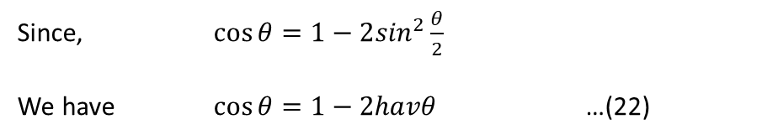
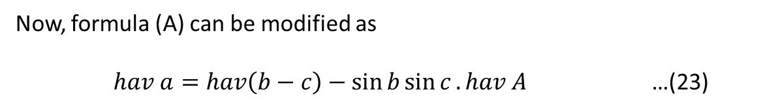
The haversine formula
Haversine is defined as

Slide 18
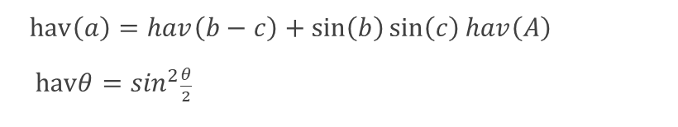
Rules & Laws
1
Fundamental formula of spherical trigonometry
2
Law of Sines
Cosine-formula
3
4
Haversine formula
Four parts formula
cos(inner side).cos(inner angle) = sin(inner side).cot(other side) – sin(inner angle).cot(other angle)

Slide 19
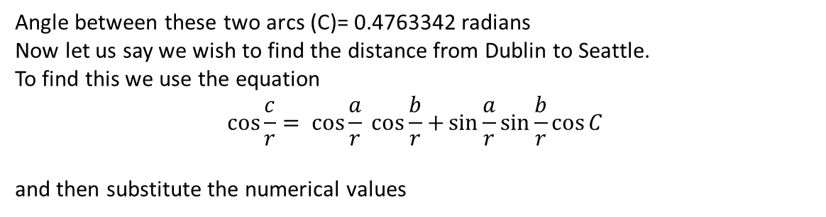
Example 1
Spherical trigonometry is very applicable to our every day life. One of these applications is discovering the length and directions needed for navigation. The formulas easily apply to the earth because the latitude and longitude lines are actually examples of great circles.
The law of cosines can be used on the example below, in which we want to find the distance between two cities.
Given:
Earth’s radius: 6,370 km
Distance from (C)San Francisco, California to (b)Dublin, Ireland: 8850 km
Distance from (C)San Francisco, California to (a)Seattle, Washington: 1094 km
B
C=??
A
a
b
C
c = 7232 km
This value is an estimation because it assumes the earth is a perfect sphere with no dips or irregularities which is not true. This estimation is useful as it is so quick and easy to find.

Slide 20
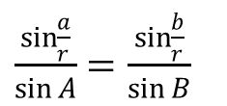
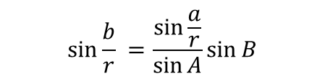


Example 2
Suppose that we have three lunar rovers, say A,B, and C respectively. Now suppose we wish to find the distance between two of these such rovers. We can use the following given information and the Law of Sines to find the unknown distance.
B
Radius of moon:1737 km
Distance between rover C and B, i.e. length a : 10 km
Angle created at rover B: 3π/4
Angle created at rover A: π/6
We need to find, How far are rovers A and C that is length of b.
C
A
a=10Km
b=??
C
We have,
Substituting values ,
Thus, the distance between rover A and rover C is around 14 km.

Slide 21
MATLAB
MATLAB environment behaves like a super-complex calculator. You can enter commands at the >> command prompt.
MATLAB is an interpreted environment. In other words, you give a command and MATLAB executes it right away.

Slide 22
Assignment I
solve the spherical triangle problems below. These twelve problems appear to be worthless rote tasks, however they are all unique. All values are in degree.
a = 64 b = 33 c = 37 C = ?
a = 39 b = 48 C = 74 c = ?
a = 16 b = 37 C = 42 B = ?
a = 21 b = 43 A = 29 c = ?
a = 67 b = 54 A = 39 B = ?
a = 49 b = 59 A = 14 C = ?
A = 24 B = 72 c = 19 a = ?
A = 79 B = 84 c = 12 C = ?
A = 62 B = 49 a = 44 b = ?
A = 59 B = 32 a = 62 c = ?
A = 47 B = 57 a = 22 C = ?
A = 79 B = 62 C = 48 c = ?

Slide 23
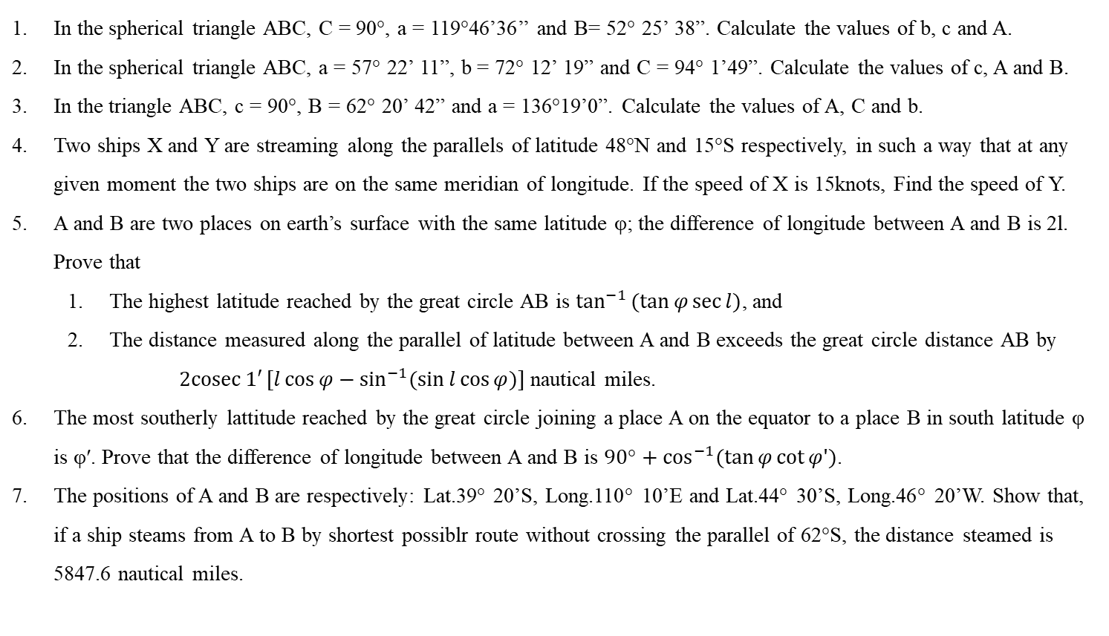
Assignment-II

Slide 24
Assignment I Answers
28° 18’.2
49° 32’.4
117° 31’.0
30° 46'.7 or 47° 37’.3
33° 34’.8
3° 18'.1 or 162° 03’.9
7° 38’.2
20° 46’.6
36° 25’.5
76° 27’.7
80° 55'.7 or 169° 05’.2
28° 54'.6

Slide 25
Celestial sphere
Declination and hour angle
Diagram for the southern hemisphere
Circumpolar stars
Standard or geocentric Celestial Sphere
Solution if the Spherical Triangle
Right ascension and declination
The earth’s orbit
Celestial latitude and longitude
Sidereal time
Mean solar time
Hour angle of a heavenly body
Rising and setting
Rate of change of Zenith Distance
Twilight

Slide 26
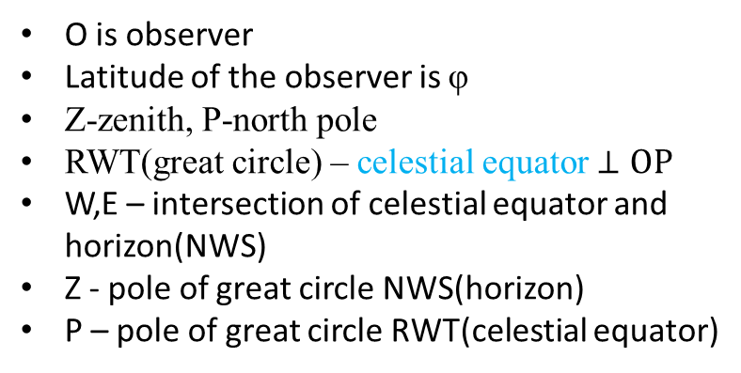
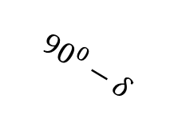
Declination and hour angle
90°-φ
Z
O is observer
Latitude of the observer is φ
Z-zenith, P-north pole
RWT(great circle) – celestial equator $⊥OP$
W,E – intersection of celestial equator and horizon(NWS)
Z - pole of great circle NWS(horizon)
P – pole of great circle RWT(celestial equator)
P
H
A
L
$${90}^{0}−δ$$
R
X
E
G
D
N
O
Y
S
Above information clears
W is 90° from the both Z and P therefore 90° from all the points on great circle through Z and P.
M
W
C
T
NW = 90° and WS = 90°
Similarly,
EN = 90° and ES = 90°

Slide 27
Declination and hour angle
Rotation of earth results in an apparent rotation of the celestial sphere from east to west about OP.
90°-φ
Z
P
H
A
L
$${90}^{0}−δ$$
Apparent rotation
R
WEST
EAST
X
E
G
D
N
O
Y
S
M
W
C
T
Earth’s rotation

Slide 28
Declination and hour angle
90°-φ
Z
As stars are at such great distances from the earth
Angle between the straight line joining the observer at O to any particular star X and the straight line OP (II to the earth’s axis) remains unaltered
P
H
A
L
$${90}^{0}−δ$$
R
X
E
Consider a Star X then,
Earth’s rotation makes it appear to describe a small circle LXM II celestial equator(TWR)
G
O
D
N
Y
S
M
W
C
Let PXDQ – semi-great circle through X and the poles of the celestial sphere
Then,
DX – Declination of the star
T
If the star is in between the celestial equator and the north pole P
declination is north
for star at X.
If the star is in between the celestial equator and the south pole Q
declination is South
For star at Y.
Q

Slide 29


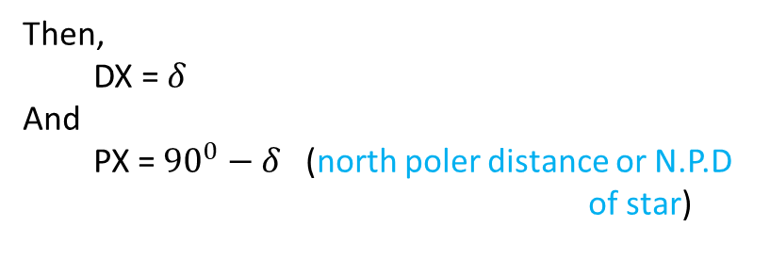
Declination and hour angle
Declination is analogous to latitude for points on the earth’s surface
90°-φ
Z
P
H
A
L
Denote declination of X by $δ$
$${90}^{0}−δ$$
Then,
DX = $δ$
And
PX = ${90}^{0}−δ$ (north poler distance or N.P.D of star)
R
X
E
G
D
N
O
Y
S
We will take declination as an algebraic quantity for convenience
M
W
C
North declination = + $δ$
South declination = $−δ$
T
We can specify a circle called Parallel of declination on which star must lie.
Here for star at X its circle LXM
Q

Slide 30
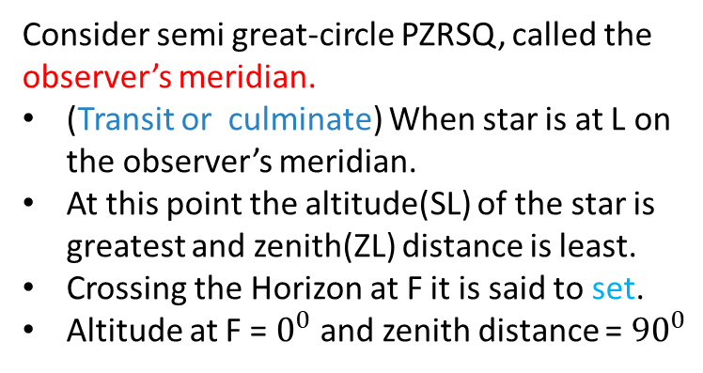
Declination and hour angle
To completely fix the position of the star at any moment.
90°-φ
Z
P
H
A
Consider semi great-circle PZRSQ, called the observer’s meridian.
(Transit or culminate) When star is at L on the observer’s meridian.
At this point the altitude(SL) of the star is greatest and zenith(ZL) distance is least.
Crossing the Horizon at F it is said to set.
Altitude at F = $0^{0}$and zenith distance = ${90}^{0}$
L
$${90}^{0}−δ$$
R
X
E
G
D
N
O
Y
S
F
Depending on declination, for an interval of time, the star is below the horizon and reaches its maximum depression below the horizon at M.
and then,
it reaches at G where it is said to rise.
M
W
C
T
Q
At any moment Star’s position on the parallel of declination is specified by the angle at P between observer’s meridian and the star’s meridian(PXQ)

Slide 31
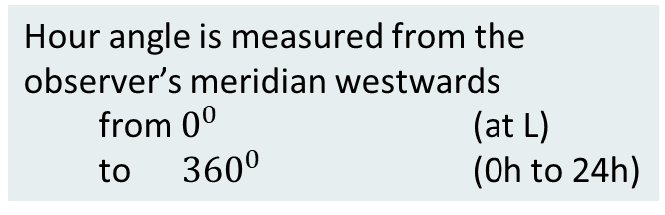
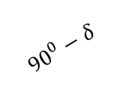
Declination and hour angle
At any moment,
Star’s position on the parallel of declination
is specified by the angle at P
between observer’s meridian and the star’s meridian(PXQ)
Denote this angle by H, (hour angle)
Z
90°-φ
A
H
P
L
$${90}^{0}−δ$$
R
X
Hour angle is measured from the observer’s meridian westwards
from $0^{0}$ (at L)
to ${360}^{0}$ (0h to 24h)
W
F
D
S
O
N
G
C
E
M
T
Azimuth
The direction of a celestial object from the observer,
expressed as the angular distance from the north or south point of the horizon to the point at which a vertical circle passing through the object intersects the horizon.
Q

Slide 32
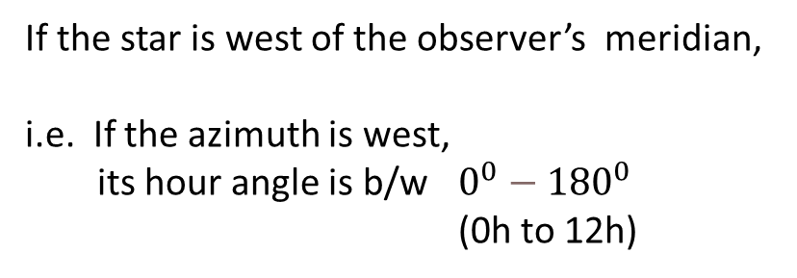
Declination and hour angle
If the star is west of the observer’s meridian,
i.e. If the azimuth is west,
its hour angle is b/w $0^{0}{− 180}^{0}$ (0h to 12h)
Z
90°-φ
A
H
P
L
$${90}^{0}−δ$$
R
X
The Rules:
If the star’s azimuth is west, the hour angle is between 0h and 12h.
If the star’s azimuth is east, the hour angle is between 12h and 24h.
W
F
D
S
O
N
G
C
E
M
T
Q

Slide 33
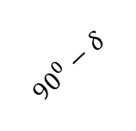
Diagram for the southern hemisphere
In the southern hemisphere,
South celestial pole Q is above the horizon.
Z
Greatest altitude of star
90°-φ
Q
A
H
L
z
Φ – southern latitude of observer
QZ = 90°- φ
R
$${90}^{0}−δ$$
X
Celestial equator and the Horizon intersect in the west and east points W and E.
D
O
S
Consider a Star at X with South declination, Lying between the celestial equator and the south pole Q.
Earth’s rotation will move the observer’s meridian westwards, (indicated with arrows)
Angle ZQX is measured 0h to 24h Westwards from observer’s meridian.
N
Horizon
F
M
C
W
Celestial Equator
T
P

Slide 34
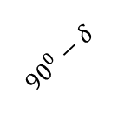
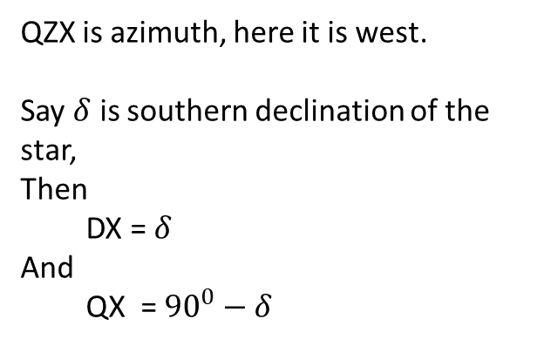
Diagram for the southern hemisphere
QZX is azimuth, here it is west.
Say $δ$ is southern declination of the star,
Then
DX = $δ$
And
QX = ${90}^{0}−δ$
Z
90°-φ
A
H
Q
L
z
$${90}^{0}−δ$$
Now we have spherical triangle QZX
QZ = 90°-φ
ZX = z (zenith distance)
QZX = A (Azimuth)
ZQX = H (the Hour angle)
X
When the Star’s Azimuth is west => hour angle $∋$ [0,12] hour
When the Star’s Azimuth is east => hour angle $∋$ [12,24] hour

Slide 35
Diagram for the southern hemisphere
L
R
X
D
O
S
N
Horizon
C
W
F
M
Celestial Equator
T

Slide 36
Circumpolar stars
Consider the celestial sphere for an observer in the northern latitude φ.
X,Y – parallels of declination above the horizon
Z
Upper culmination
P
L
Y
So they don’t set and called as Circumpolar star.
X
If M is the position of star
And ,
PM < PN
Or,
Colatitude < North polar distance
Then star is Circumpolar star.
R
M
Lower culmination
N
O
G
Culmination above pole
When star X is on the observer’s meridian at L, it is at upper culmination or transit.
culmination below pole
When Star reaches at M, it is at lower culmination
W
T
Q

Slide 37
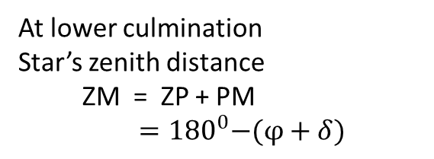
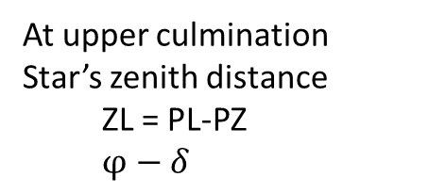
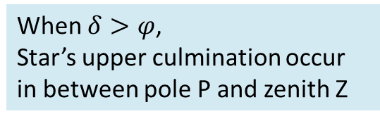
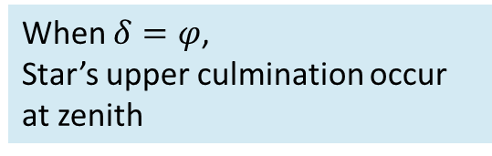
Circumpolar stars
At upper culmination
Star’s zenith distance
ZL = PL-PZ
$φ−δ$
Z
Upper culmination
P
L
Y
At lower culmination
Star’s zenith distance
ZM = ZP + PM
${ =180}^{0}−(φ+δ)$
X
R
M
Lower culmination
When $δ=φ$,
Star’s upper culmination occur at zenith
O
N
G
W
When $δ>φ$,
Star’s upper culmination occur in between pole P and zenith Z
T
Q

Slide 38


Standard or geocentric celestial sphere
Z
P
X
Y
M
$$P_{1}$$
O
r
C
$$Q_{1}$$

Slide 39
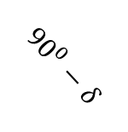
Standard or geocentric celestial sphere
90°-φ
Z
P
H
A
L
z
$${90}^{0}−δ$$
R
X
G
E
D
N
C
Y
S
M
F
W
T
Q

Slide 40
Solution of the spherical triangle

Slide 41

Right ascension and declination
Z
P
R
X
D
N
C
$$τ$$
S
Horizon
W
Celestial Equator
T
Q

Slide 42
The Earth’s orbit
G
S
A
B
E
F
g
C
a
b
e
f

Slide 43



The Earth’s orbit
P
K
$$∈$$
$${90}^{0}−δ$$
L
$${90}^{0}−β$$
M
X
U
C
T
R
Celestial Equator
r
D
Y
Ecliptic
Q

Slide 44


Celestial Latitude and longitude
The position of a celestial body can be referred to the ecliptic as fundamental great circle and the vernal equinox r as principal reference point.
P
K
$$∈$$
Let
K – the pole of the ecliptic
And
KXA – great circle arc passing through X
and meeting the ecliptic in A
$${90}^{0}−β$$
$${90}^{0}−δ$$
L
M
X
U
A
The arc rA measured from r to A along the ecliptic in the direction of the sun’s annual motion,
C
T
R
Celestial Equator
r
D
i.e. eastwards, is called the longitude of the heavenly body X and measured from 0° to 360° round the ecliptic.
Ecliptic
Y
Q
The arc AX is the latitude and measured north to south.

Slide 45

Celestial Latitude and longitude
If we know the star’s right ascension and declination
We can obtain its latitude (β) and its longitude (λ) from the triangle KPX
And vice-versa.
Now
r is the pole of the great circle KPMR
Hence
KPr = 90°
And since
rD = rPX = α
Then
$KPX=90°−λ$
Also
$PX=90°−δ$ and $KX=90°−β$

Slide 46
Sidereal time
P
G
X
p
g
L
r
l
Q

Slide 47

Mean solar time
Z
P
R
Sun
M
N
C
K
S
W
T
$$r$$
Q

Slide 48
Example

Slide 49
Hour angle of heavenly body

Slide 50



Rising and setting
Heavenly body X is said to set at F (the point where it reaches the horizon)
There zenith distance is 90°
Z
P
ZF = 90°
L
Let H be the Hour angle of X at setting,
ZPF = H
Also
PF = 90° - δ
R
Let A – azimuth at setting (PZF)
and φ – latitude.
C
N
S
From formula A
F
W
Horizon
M
Celestial Equator
$$\cos{ZF}=\cos{PZ\cos{PF}}+\sin{PZ\sin{PF\cos{ZPF}}}$$
T
$$\cos{\text{90}\text{°}}=\sin{φ}\sin{δ}+\cos{φ\cos{δ\cos{H}}}$$
Q
$$\cos{\text{90}\text{°}\text{ = 0}}$$
$$\sin{φ}\sin{δ}=−\cos{φ\cos{δ\cos{H}}}$$
$$\cos{H}=−tan{φ}\tan{δ}$$
The hour angle can be calculated from here

Slide 51




Rising and setting
Also from formula A
$$\cos{PF}=\cos{PZ\cos{ZF}}+\sin{PZ\sin{ZF\cos{PZF}}}$$
$$\sin{δ}=0+\cos{φ\cos{A}}$$
$$\cos{A}=\sin{δ}\sec{φ}$$
Azimuth at setting can be calculated from here
Z
P
In north latitudes
Its clear from
or
$$\cos{A}=\sin{δ}\sec{φ}$$
L
$$\cos{H}=−tan{φ}\tan{δ}$$
R
That if
The declination is north
the hour angle at setting is between 6h and 12h
and that the azimuth is less then 90°
The body sets between west and north
N
C
S
F
W
Horizon
M
Celestial Equator
That if
The declination is south
the hour angle at setting is between 0h and 6h
The body sets between south and west
T
Q

Slide 52



Rate of change of zenith distance and azimuth
X – any heavenly body , at certain instant
Y – position of same body after a while
Assume,
constant declination (so that X and Y lie on the small circle LM)
PX,PY,ZX,ZY – great circle arcs
Let,
UX be an arc of a small circle of which Z is the pole
Then
ZX = ZU
Let
ZPX = H and ZPY = $H+∆H$
So that XPY = $∆H$
Let
ZX = A and XZY = $∆A$
=> ZX = z and ZY = $z+∆H$
Then,
UY = $∆z$
Since UXY is a plane triangle and right angled at U
Z
P
90°- φ
H
A
$$∆A$$
L
$$∆H$$
U
R
X
Y
C
N
S
Horizon
F
W
M
Celestial Equator
T
Q

Slide 53






Rate of change of zenith distance and azimuth
As the heavenly body moves, owing to the diurnal motion, from X to Y
its zenith distance increases by $∆z$
Its hour angle by $∆H$
Its azimuth decreases by $∆A$
By the formula
90°- φ
Z
P
H
A
$$∆A$$
P
L
( PA = 90 ̊)
$$∆H$$
$$CD=AB\sin{PC}$$
F
R
D
R
C
U
X
XY = $\operatorname{XPYsin}{PX}$ = $∆H\cos{δ}$,
and UX = $\operatorname{XZYsin}{ZX}$ = $∆A\sin{z}$
Let
$η$ - $angle$PXZ
$η$ is called parallactic angle.
E
o
A
Y
N
C
S
Horizon
F
W
Q
M
Then,
since Y is very close to X, we may take PYZ to be $η$.
Then
UY = $\operatorname{XYcos}{UYX}$
And UX = XY $\sin{UYX}$
Celestial Equator
T
Q

Slide 54




Rate of change of zenith distance and azimuth
Now
PYZ = $η$ and PYX = 90°
Hence
$UY≡∆z=∆H\cos{δ}\sin{η}$
$UX≡∆A\sin{z}=∆H\cos{δ}\sin{η}$
90°- φ
Z
P
H
A
$$∆A$$
L
$$∆H$$
Now in the spherical triangle PXZ, by formula B (slide 17)
$\cos{δ}\sin{η}=\sin{A}\cos{φ}$
U
R
X
And by formula C
Y
N
C
S
$\sin{a}\cos{B}=$ $\sin{c}\cos{b}−\cos{c}sin{b}\cos{A}$ …(C)
$\sin{δ}\cos{η}=$ $\sin{φ}\sin{z}−\cos{φ}cos{z}\cos{A}$
Horizon
F
W
M
Hence,
$∆z=∆H\sin{A}\cos{φ}$ …(26)
and
$∆z=∆H(\sin{φ}−\cos{φ\cot{z}\cos{A})}$
Celestial Equator
T
Q
$∆H$, $∆z$ and $∆A$ are in circular measure

Slide 55






Rate of change of zenith distance and azimuth
Let
$ΔH^{s}$ denote the number of seconds(time) in ∆H radians
Let
$Δz^{′′}$, $ΔA^{′′}$ denote the number of seconds(arc) in ∆z and ∆A radians respectively
By trigonometrical ratios for small angles
$$∆z=Δz^{′′}\sin{1′′}$$
$$∆A=ΔA^{′′}\sin{1′′}$$
$$∆H=ΔH^{s}\sin{1^{s}}$$
Since
$\sin{1^{s}}$ = $15 sin{1^{′′}}$
We have
$Δz^{′′}=15 ΔH^{s}\sin{A}\cos{φ}$ $ΔA^{′′}=15 ΔH^{s}(sin{φ}−\cos{φ\cot{z}\cos{A}}$)
If $ΔH^{s}=1sec$
These equations express respectively that
the zenith distance increases at the rate of $15 \sin{A}\cos{φ}seconds$ of arc time second of time
The azimuth is decreasing at the rate of $15 (sin{φ}−\cos{φ\cot{z}\cos{A}}$) seconds of arc per second of time.

Slide 56





Rate of change of zenith distance and azimuth
If the heavenly body is a star, the rate of change of zenith distance
And the rate of change of azimuth are expressed in terms of seconds of arc per second of sidereal time
In the case of sun
The rates are in terms of seconds of arc per second of apparent solar time
Z
P
90°- φ
H
A
From the triangle PZX, by formula A
$$∆A$$
L
$$∆H$$
U
R
$$\cos{z}=\sin{δ\sin{φ}}+\cos{δ\cos{φ\cos{H}}}$$
X
Suppose δ, φ are constant
then
Y
$$\sin{z}\frac{ⅆz}{ⅆH}=\cos{δ\cos{φ\sin{H}}}$$
N
C
S
Horizon
F
W
M
$$\sin{z\sin{A}}=\sin{H\cos{δ}}$$
Celestial Equator
T
$$∴ \frac{ⅆz}{ⅆH}=\sin{A\cos{φ}}$$
Q
Same as (26)

Slide 57





Rate of change of zenith distance and azimuth
If
z is expressed in terms of seconds of arc
H is expressed in terms of seconds of time
$$\frac{ⅆz}{ⅆH}=15\sin{A\cos{φ}}$$
$$\sin{z}\cot{A\frac{ⅆA}{ⅆH}}=\cos{H\cos{δ}}−\sin{A\cos{z}\frac{ⅆz}{ⅆH}}$$
$$\frac{ⅆz}{ⅆH}=\sin{A\cos{φ}}$$
$$=cos{Hcos δ{−\sin^{2}{A\cos{z}\cos{φ}}}}$$
From the previous slide
Again using formula C
$\sin{a}\cos{B}=$ $\sin{c}\cos{b}−\cos{c}sin{b}\cos{A}$ …(C)
$\cos{δ}\cos{H}=$ $\cos{φ}\cos{z}−\sin{φ}sin{z}\cos{A}$
$$∴ sin z{\cos{A}\frac{ⅆA}{ⅆH}}=\cos^{2}{A\cos{z}\cos{φ}}−\sin{z\sin{φ}}\cos{A}$$
$$∴{ \frac{ⅆA}{ⅆH}}=−(\sin{φ}−\cot{z}\cos{A}\cos{φ})$$

Slide 58

Rate of change of zenith distance and azimuth
If
A is expressed in terms of seconds of arc
H is expressed in terms of seconds of time
then
$${ \frac{ⅆA}{ⅆH}}=−15(\sin{φ}−\cot{z}\cos{A}\cos{φ})$$
Which we already derived

Slide 59










Twilight

